Slide 1

Artificial Intelligence in the Intensive Care Unit
Andrew Neary (a.neary6@nuigalway.ie)
Supervisor: Prof. Michael Madden

Slide 2
AI in Medicine: Why?
Improve the standard of care
Always the driving factor!
Precision medicine
Improvements in technology
Increased use of continuous patient monitoring
Deliver healthcare more efficiently
Both in terms of resources and financial cost

Slide 3
Many Areas of Research
Decision support
systems ^{[4]}
Drug
development ^{[1]}
AI in Medicine
Supporting
disease
diagnosis ^{[5]}
Radiology ^{[2]}
Medical
devices ^{[3]}
Many others!

Slide 4
Ethical Considerations
Explainability
Patient confidentiality
Bias
Aligning incentives

Slide 5
The Intensive Care Unit

Slide 6
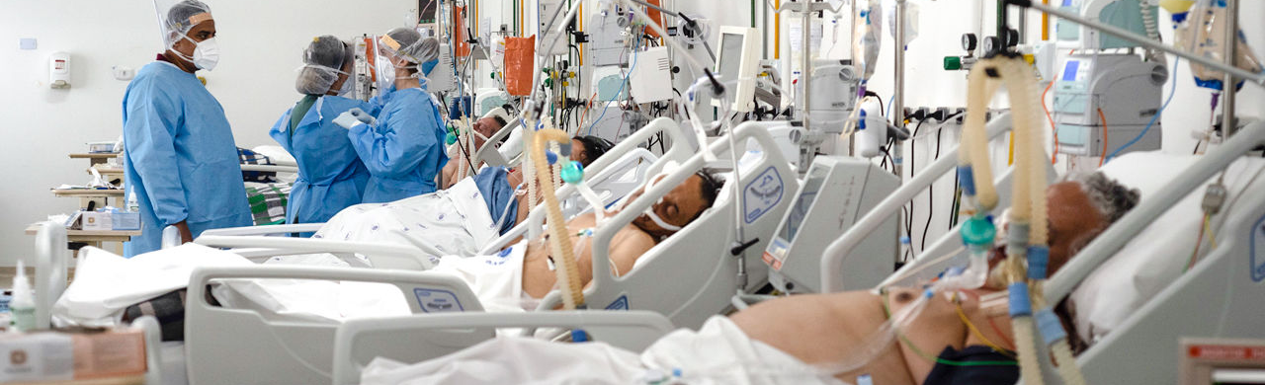
What is an ICU?
Hospital unit for patients with severe or life-threatening illnesses or injuries
Staffed by specialized healthcare staff
High staff-to-patient ratio
Extensive use of monitoring devices
https://www.sciencemag.org/news/2020/09/why-covid-19-more-deadly-people-obesity-even-if-theyre-young

Slide 7
AI in the ICU
Mortality
Prediction ^{[6]}
Length of stay
prediction ^{[7]}
Supporting
disease
diagnosis ^{[5]}
Mechanical ventilation
AI in the icu

Slide 8
Mortality Prediction
Why are we interested in mortality prediction?
Implement models in “Benchmarking deep learning models on large healthcare datasets,” Purushotham et al, 2018 ^{[8]}
38,549 adult patients from the MIMIC-III database
16 features for each patient
Age, heart rate, systolic blood pressure, temperature, GCS, P_{a}O₂, F_{i}O₂, urine output, urea, bicarb, sodium, potassium, bilirubin, WBCs, chronic diseases, admission type
Predicting the probability of surviving the hospital stay

Slide 9
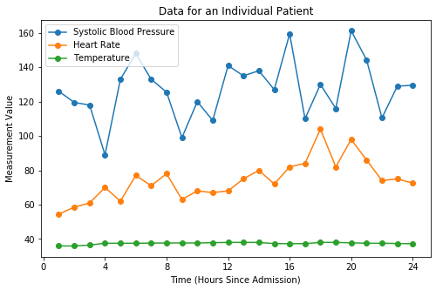
Data

Slide 10
The Classifiers
SAPS II
Clinical warning score taken from medical literature
Uses the same features to calculate probability of patient survival
Recurrent neural network
Gated Recurrent Unit (GRU)
Capture information in the time series data
Logistic regression
Used to benchmark results
Summary statistics calculated for time series features

Slide 11
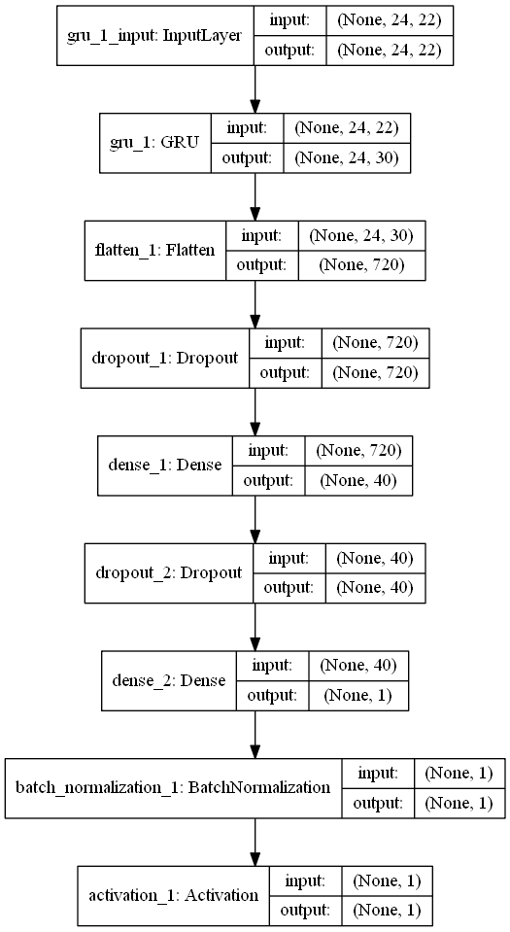
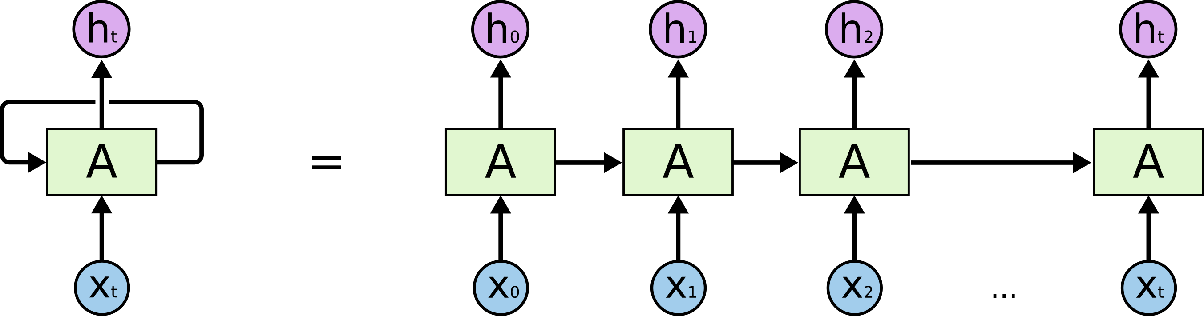
Recurrent Neural Network
https://towardsdatascience.com/understanding-rnn-and-lstm-f7cdf6dfc14e

Slide 12
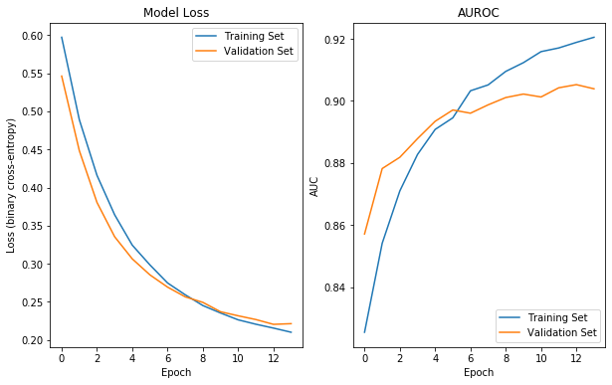
Training

Slide 13
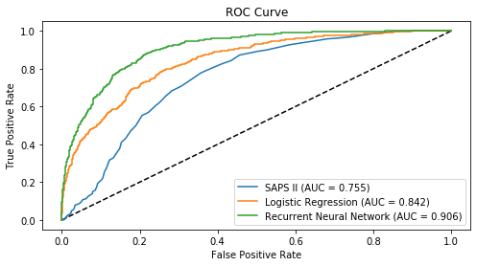
Results

Slide 14
Mechanical Ventilation

Slide 15
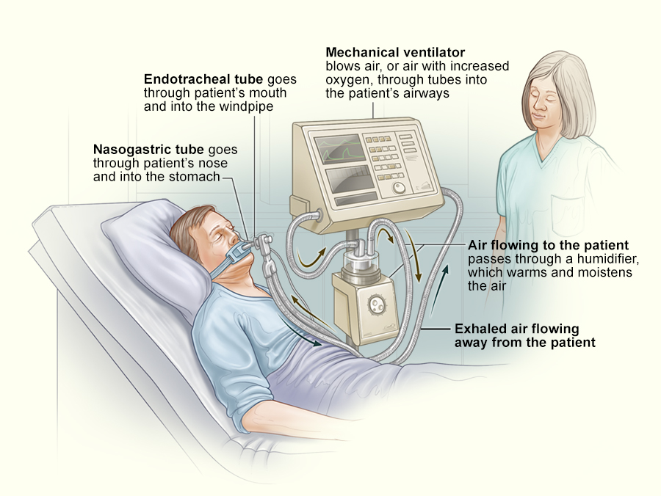
What Is Mechanical Ventilation?
Device used to assist or replace a patient’s spontaneous breathing
Used to maintain patient stability
Serious risks with prolonged use:
Lung injury
Respiratory muscle wasting
Infection
https://www.nhlbi.nih.gov/health-topics/ventilatorventilator-support

Slide 16
AI in Mechanical Ventilation
Patient-ventilator
asynchrony ^{[9]}
AI in Ventilation
Weaning from
mechanical
ventilation ^{[11]}
Control of
ventilator
settings ^{[10]}

Slide 17
AI in Ventilation: The Ultimate Goal
Ultimate goal is adaptive closed-loop control – long way off
Research starting to look at the use of reinforcement learning to learn optimal policies for ventilator control
Problem – defining reward function:
Inverse reinforcement learning? ^{[12]}
Stuart Russell’s ‘new model’ of AI

Slide 18
Next Steps
Continued collaboration with clinical partners
Prof. John Laffey, NUIG
Identify ventilation problem of importance to clinicians

Slide 19
References
[1] K. Mak and M. Pichika, "Artificial intelligence in drug development: present status and future prospects", Drug Discovery Today, vol. 24, no. 3, pp. 773-780, 2019
[2] Ardila, D., Kiraly, A.P., Bharadwaj, S. et al. ”End-to-end lung cancer screening with three-dimensional deep learning on low-dose chest computed tomography”. Nat Med 25, 954–961, 2019
[3] "Artificial pancreas algorithm used in new Medtronic system", Med-Tech Innovation | Latest news for the medical device industry, 2020. [Online]. Available: https://www.med-technews.com/news/artificial-pancreas-algorithm-used-in-new-medtronic-system/
[4] F. Tehrani, "A computerized decision support system to predict the variations in the cerebral blood flow of mechanically ventilated infants", Computers in Biology and Medicine, vol. 43, no. 10, pp. 1402-1406, 2013
[5] Tomašev, N., Glorot, X., Rae, J.W. et al. ”A clinically applicable approach to continuous prediction of future acute kidney injury”, Nature 572, 116–119, 2019
[6] R. Davoodi and M. Moradi, "Mortality prediction in intensive care units (ICUs) using a deep rule-based fuzzy classifier", Journal of Biomedical Informatics, vol. 79, pp. 48-59, 2018
[7] P. Tsai et al., "Length of Hospital Stay Prediction at the Admission Stage for Cardiology Patients Using Artificial Neural Network", Journal of Healthcare Engineering, vol. 2016, pp. 1-11, 2016
[8] S. Purushotham, C. Meng, Z. Che and Y. Liu, "Benchmarking deep learning models on large healthcare datasets", Journal of Biomedical Informatics, vol. 83, pp. 112-134, 2018
[9] L. Zhang et al., "Detection of patient-ventilator asynchrony from mechanical ventilation waveforms using a two-layer long short-term memory neural network", Computers in Biology and Medicine, vol. 120, p. 103721, 2020
[10] F. Akbulut, E. Akkur, A. Akan and B. Yarman, "A decision support system to determine optimal ventilator settings", BMC Medical Informatics and Decision Making, vol. 14, no. 1, 2014
[11] N. Prasad, LF Cheng, C. Chivers et al. “A reinforcement learning approach to weaning of mechanical ventilation in intensive care units”, Conference on Uncertainty in Artificial Intelligence Proceedings, 2020
[12] C. Yu, J. Liu and H. Zhao, "Inverse reinforcement learning for intelligent mechanical ventilation and sedative dosing in intensive care units", BMC Medical Informatics and Decision Making, vol. 19, no. 2, 2019

Slide 20
Thank you!

